Slide 1
WELCOME OUR PRESENTATION
PRESENTED BY OVERLODING GROUP

Slide 2
OUR PRESENTATION TOPIC:
PROJECT ON:OVERLOADING OVERVIEW SCIENTIFIC CALCULATOR.

Slide 3
OVERLODING GROUP MEMBERS: 1. 2.tutul hossan(id:cse06007270) 3.rakib hassan(id:cse06007262)

Slide 4
1.INTRODUCTION. 2.LIST OF USED TOTAL CLASS. 3.PROJECT FUNCTIONARIES. 4.PROJECT OUTER AND INER SWITCH. 5.NEEDED FORMULA. 6.USING C++ CONCEPT DEFINATION. 7.OUR PROJECT SWITCH USES CALCULATOR IMAGE.
CONTENTS AT A GLANCE:-

Slide 5
9.Our project code advantage and limitation. 10.project source code screenshot. 11.sample input and output screenshot with explanation. 12.future plan about our project. 13.reference. 14.overview total presentation. 15.conclution.
Continue………….

Slide 6
INTRODUCTION:

Slide 7
1.Arith 2.Trigo 3.Triangle 4.Rectangle 5.Trapezoid 6.Ellipse 7.Square 8.Parallelogram 9.Circle 10.Sector 11.Cube 12.Sphere 13.Cone
LIST OF USED TOTAL CLASS:

Slide 8
14.Torus 15.Logarithmicfunction 16.Powerfunction 17.matrix 18. factorial 19. Factorial 20.s_digit 21.Average 22.Percentage 23.Prime 24.Series 25.Converter 26.Complex
Continue………

Slide 9
1 : Arithmetic Operations . 2 : Trigonometric Functions. 3 : Logarithmic Functions. 4 : Power Functions. 5 : complex number. 6 : matrix . 7 : add digits. 8 : n! . 9 : nCr & npr. 10 : area calculate. 11 : summation different type of series. 12 : average the numbers. 13 : percentage the number. 14 : check the prime number. 15 : NUMBER SYSTERM CONVERTION. 16 : Exit.
PROJECT FUNCTIONARIES:

Slide 10
1. Arithmetic Operations 2. Trigonometric Functions 3. Logarithmic Functions
PROJECT OUTER AND INER SWITCH:
1: Addition
2: Subtraction
3: Multiply
4: Division
5: Back
6: exit
1: sin
2: cos
3: tan
4: sin^-1
5: cos^-1
6: tan^-1
7: Back
8: exit
1: ln
2: log10
3: Back
4: exit

Slide 11
4. Power Functions 5. complex number 6. Matrix 7. add digits
Continue………….
1: pow()
2: sqrt()
3: Back
4: exit
1. ADDITION
2.SUBTRACTION
3. MULTIPLICATION
4. DIVISION
5. Back
6. Exit
1. Sum of 1st and 2nd matrix
2. Difference of 1st and 2nd matrix
3. Transpose of both 1st and 2nd matrix
4. multiplication of 1st and 2nd matrix
5. Back
6. Exit
1. Add digits 2.Back
3.Exit

Slide 12
8. n! 9. nCr & npr 10. area calculate
Continue………….
1.n!
2.Back
3.Exit
1.nCr
2.nPr
3.Back
4.Exit
1: triangle
2: rectangle
3: trapezoid
4: ellipse
5: square
6: parallelogram
7: circle
8: sector
9: cube
10: sphere
11: cone
12: torus
13: Back
14: exit

Slide 13
11. summation different type of series 12. average the numbers 13. percentage the number 14. check the prime number
Continue………
1: Harmonic Progression(H.P)series
2: Geometric Progression(G.P)series
3: Arithmetic Progression(A.P)series
4: Back
5: exit
1: Average the number
2: Back
3: Exit
1: Percentage
2: Back
3: Exit
1: Check Prime Number 2: Back
3: Exit

Slide 14
15. NUMBER SYSTERM CONVERTION 16. Exit
Continue……….
1: Decimal TO Binery
2: Decimal TO Octal
3: Decimal TO HexaDecimal
4: Binery TO Decimal
5: Binery TO Octal
6: Binery TO HexaDecimal
7: Octal TO Decimal
8: Octal TO Binery
9: Octal TO HexaDecimal
10: HexaDecimal TO Decimal
11: HexaDecimal TO Binery
12: HexaDecimal TO Octal
13: Back
14: exit

Slide 15
AREA CALCULATION: 1: triangle =(base*height)/2 2: rectangle =length*width 3: trapezoid=(height*(a2+b2))/2 4: ellipse =a2*b2*PI 5: square =side*side 6: parallelogram=(base*height) 7: circle=PI*radius*radius 8: sector=(radius*radius*angle)/2 9: cube =6*radius*radius 10: sphere=4*PI*radius*radius 11: cone =PI*radius*a2 12: torus =PI*PI*(b2*b2-a2*a2) nCr & npr: 1. npr=n!/(n-r)! 2. nCr=n!/(r!*(n-r)!) AND ALSO NEED Arithmetic OPERATOR RELATED FORMULA.
NEEDED FORMULA:

Slide 16
1.Hierarchical Inheritance: When there is a need to create multiple derived classes that inherit properties of the same base class is known as hierarchical inheritance. 2.binary operator overloading: Overloading with a single parameter is called binary operator overloading. similar to unary operators, binary operators can also be overloaded. Binary operators require two operands, and they are overloaded by using member functions and friend functions.
USING C++ CONCEPT DEFINATION:

Slide 17
3. member function: A member function of a class is a function that has its definition or its prototype within the class definition like any other variable. It operates on any object of the class of which it is a member, and has access to all the members of a class for that object. 4. Classes and Objects: The classes are the most important feature of c++ that leads to object oriented programming. Class is a user defined data type, which holds its own data members and member functions, which can be accessed and used by creating instance of that class.A class in c++ is a user defined type or data structure declared with keyword class that has data and functions (also called methods) as its members whose access is governed by the three access specifiers private, protected or public (by default access to members of a class is private).
Continue…......

Slide 18
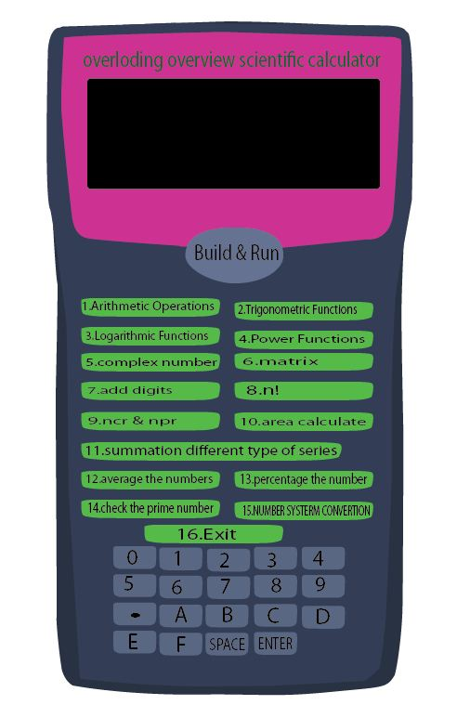
OUR PROJECT SWITCH USES CALCULATOR IMAGE:

Slide 19
Advantage: 1.Easyly back into main function. 2.Easyly exit any switch. 3.Unlimited using without command exit switch. 4.Any user can use it easyly. Limitation: 1.Complite time is around 4 second. 2.Arithmatic operation division use for only two variable divide. 3.We can not use all Arithmatic operation together. 4.switch only perform integer value.
Our project code advantage and limitation:

Slide 20
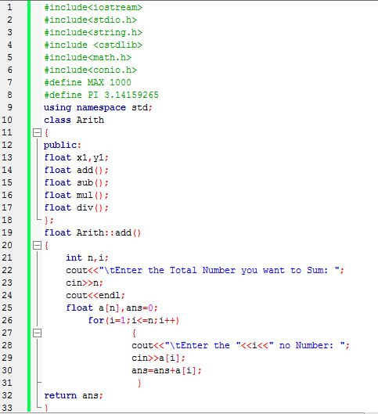
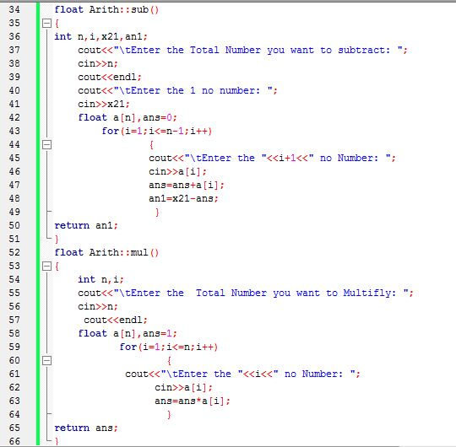
project source code screenshot:

Slide 21
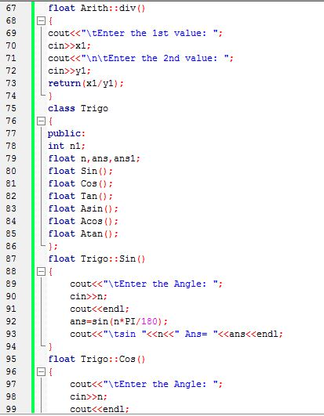
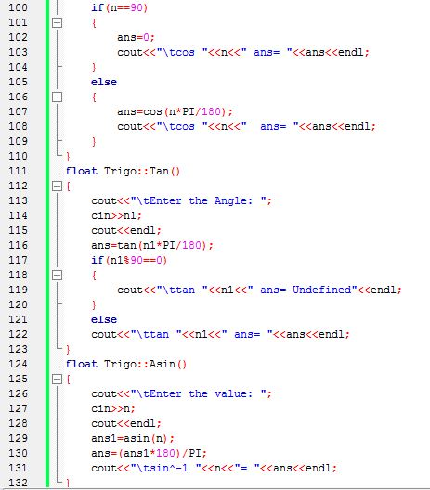
Continue………….

Slide 22
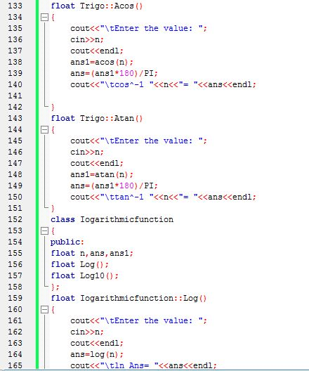
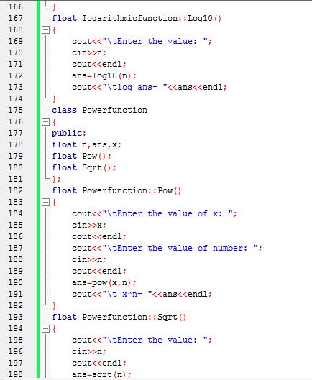
Continue……………

Slide 23
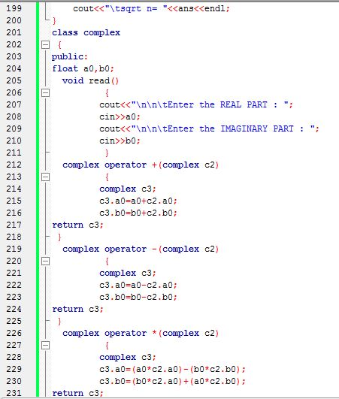
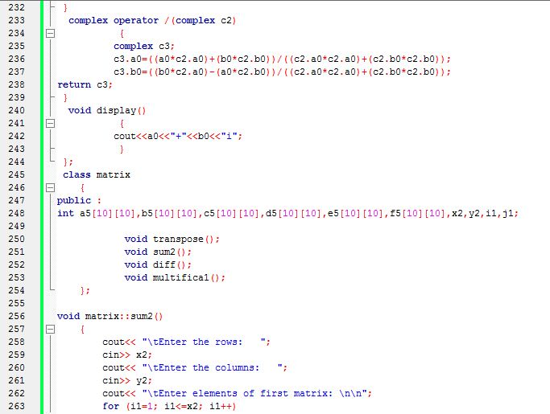
Continue…………………….

Slide 24
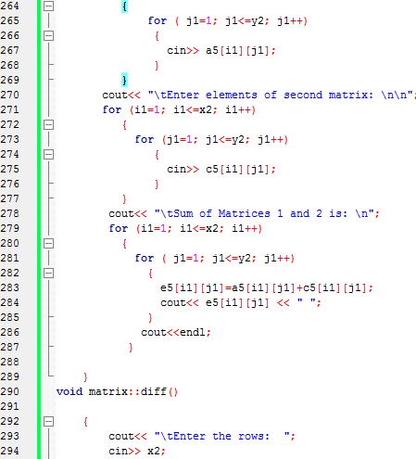
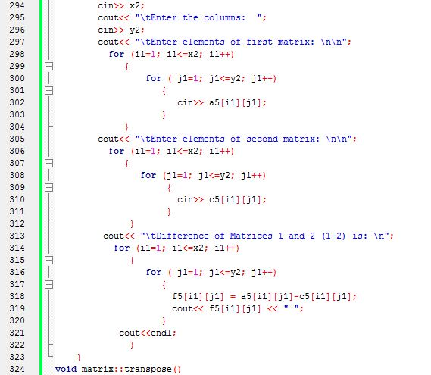
Continue…………………….

Slide 25
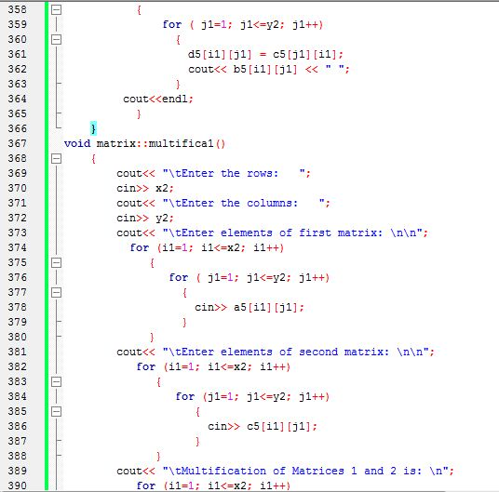
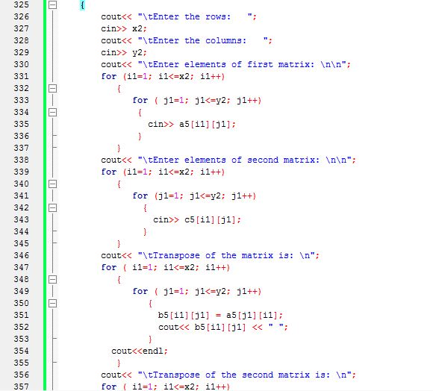
Continue…………………….

Slide 26
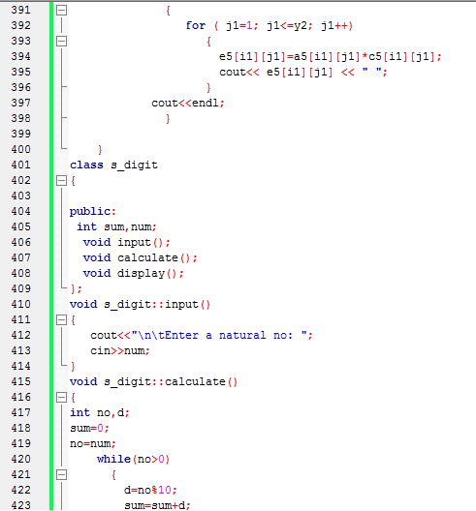
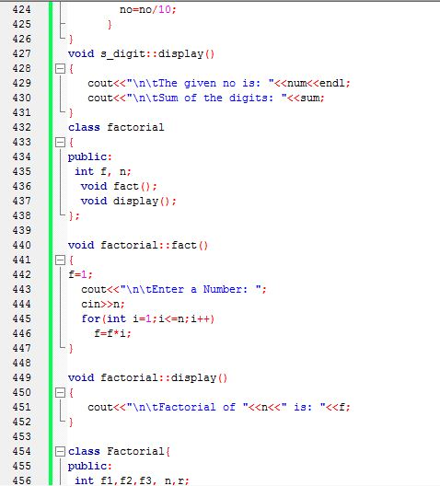
Continue…………………….

Slide 27
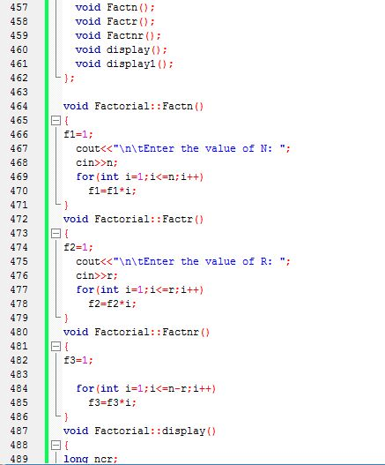
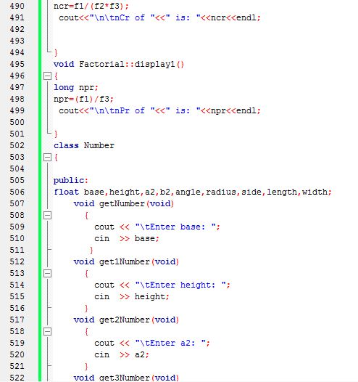

Slide 28
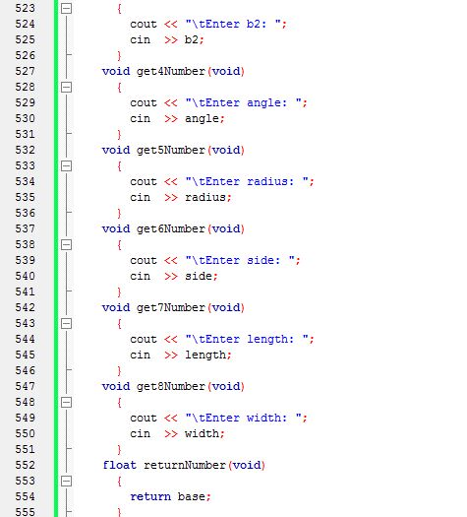
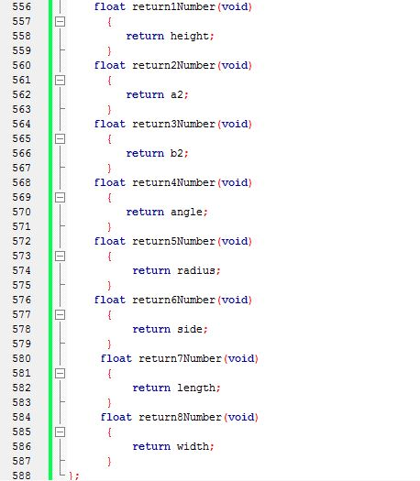
Continue…………………….

Slide 29
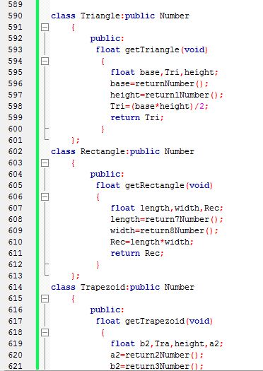
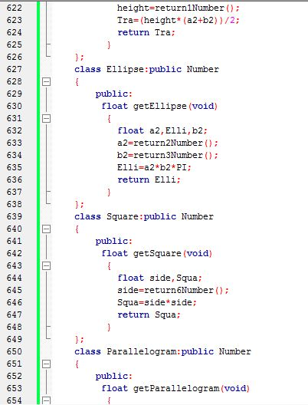
Continue…………………….

Slide 30
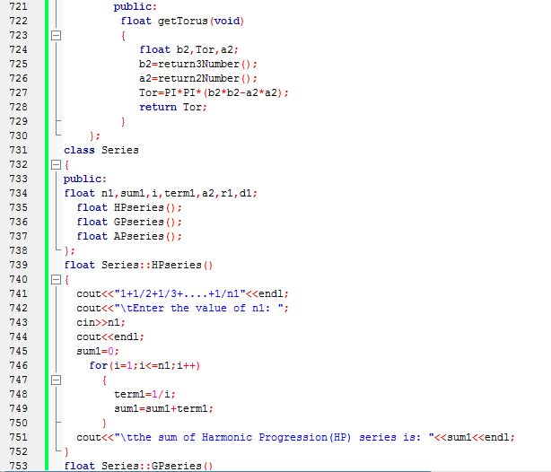
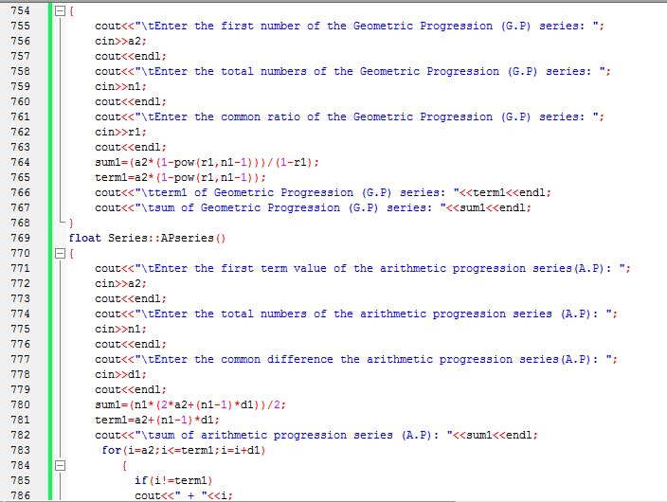
Continue…………………….

Slide 31
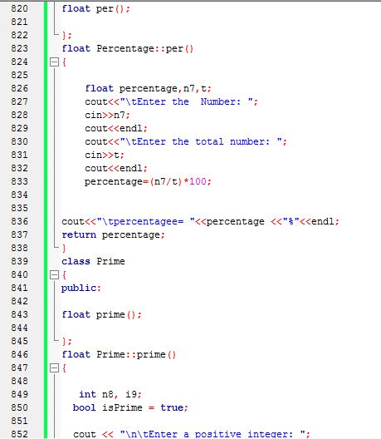
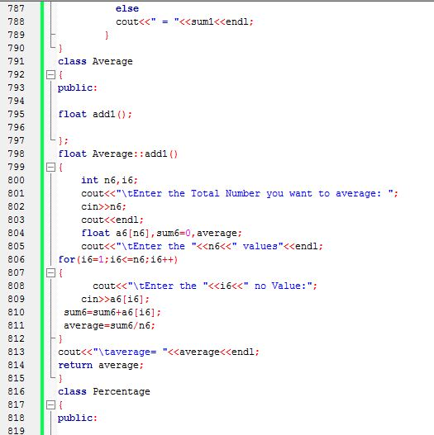
Continue…………………….

Slide 32
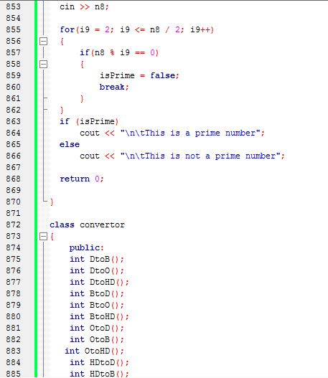
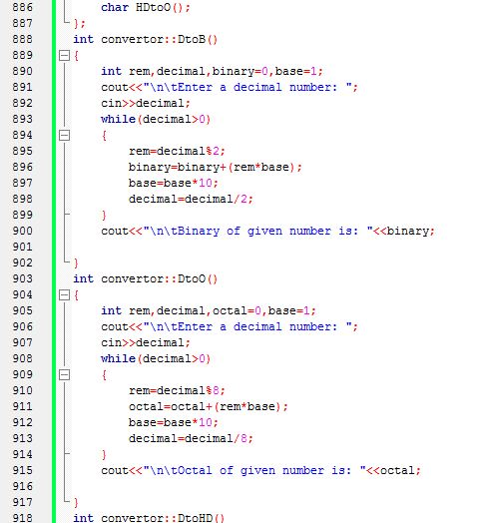
Continue…………………….

Slide 33
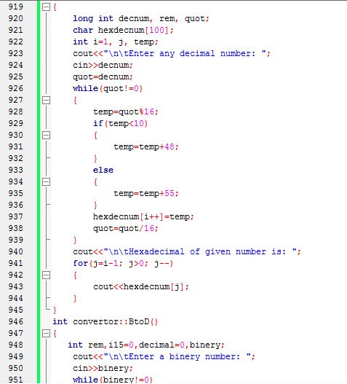
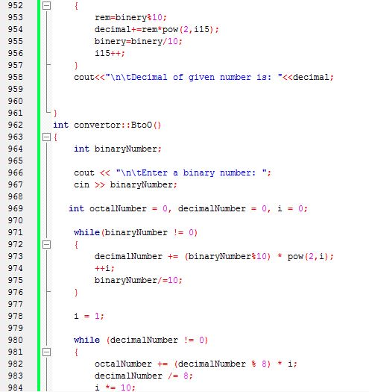
Continue…………………….

Slide 34
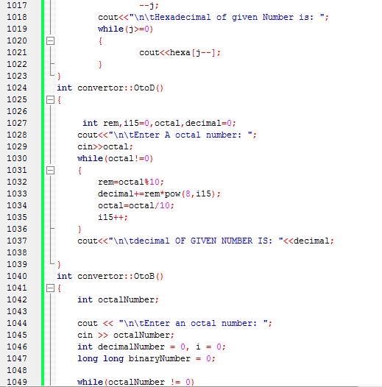
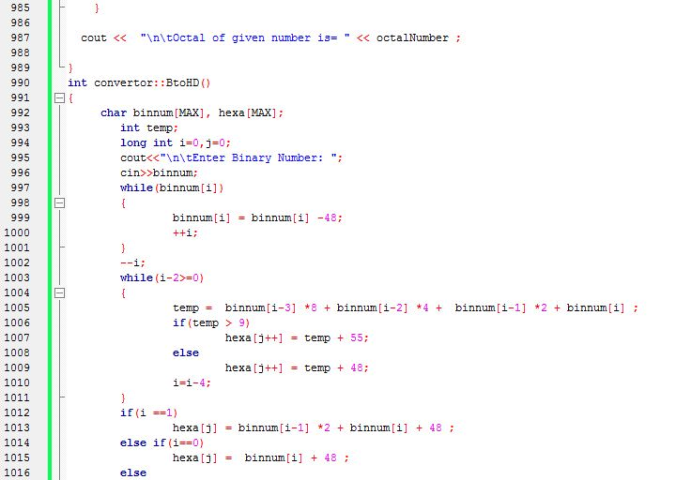
Continue…………………….

Slide 35
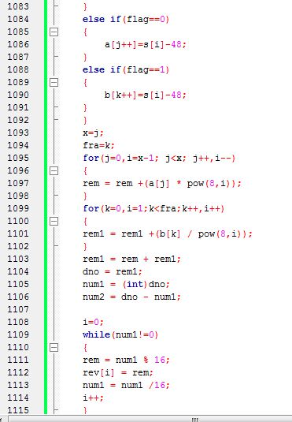
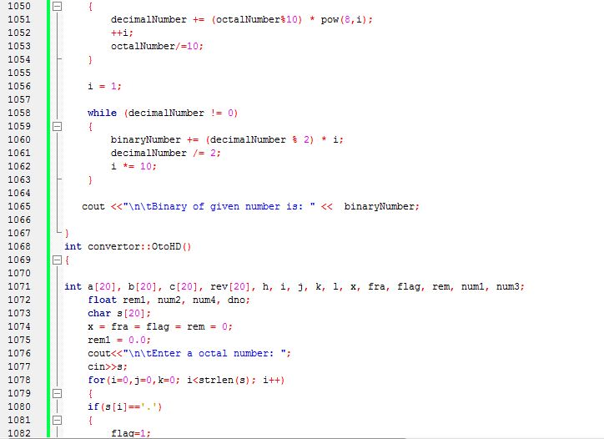
Continue…………………….

Slide 36
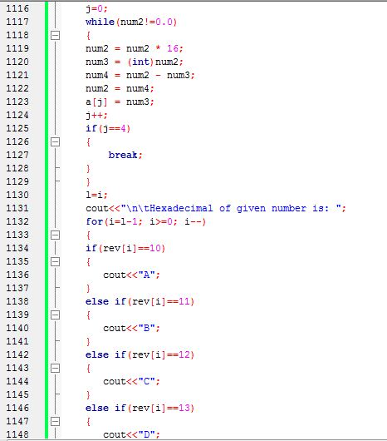
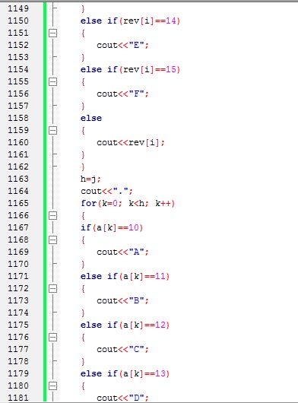
Continue…………………….

Slide 37
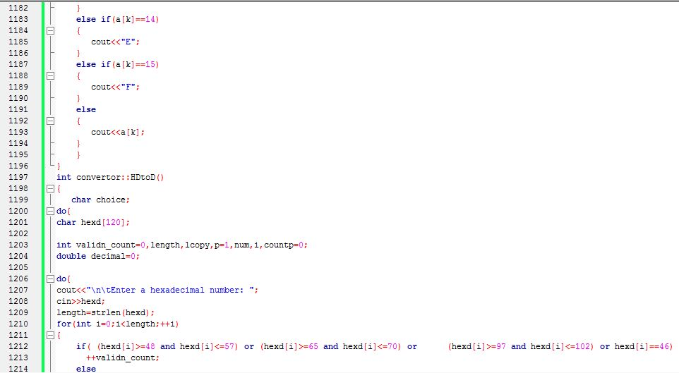
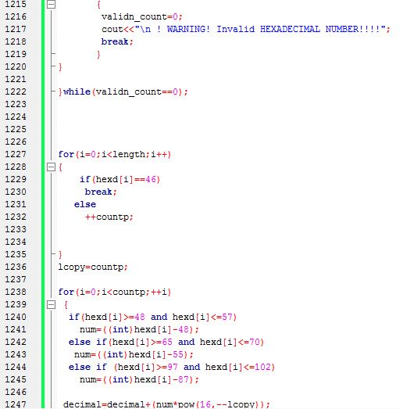
Continue…………………….

Slide 38
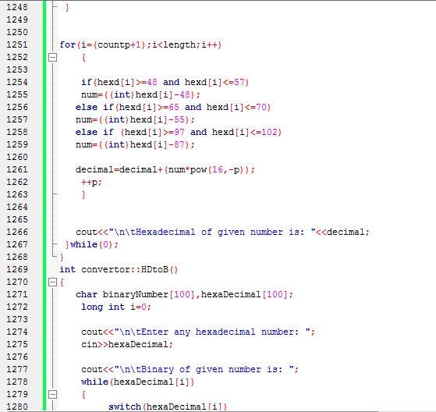
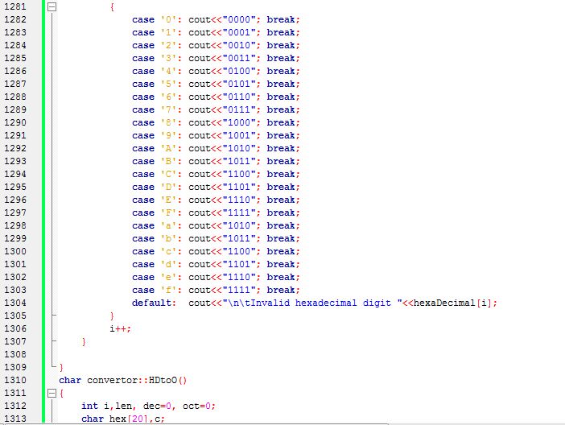
Continue…………………….

Slide 39
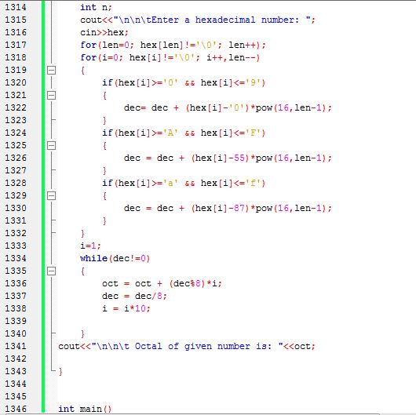
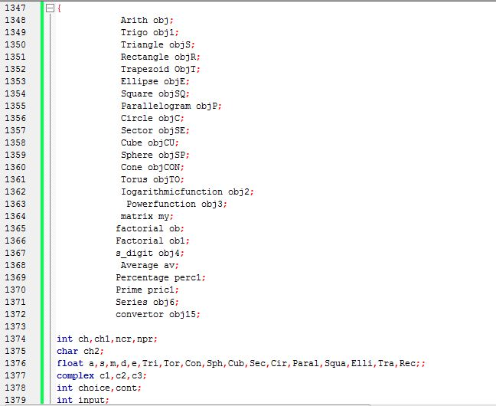
Continue…………………….

Slide 40
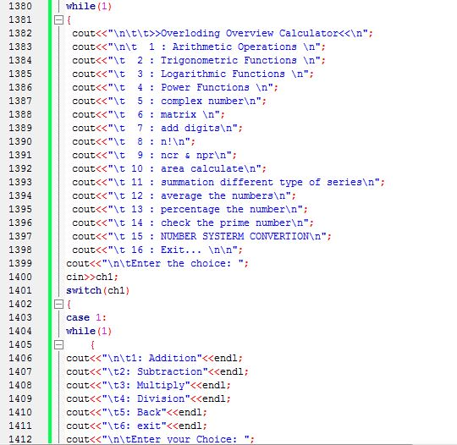
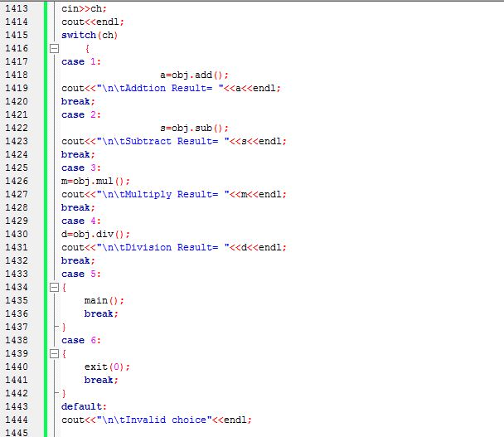
Continue…………………….

Slide 41
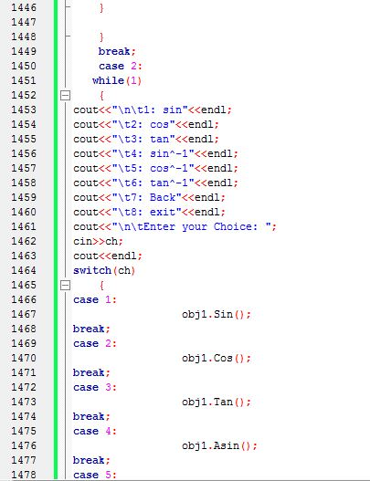
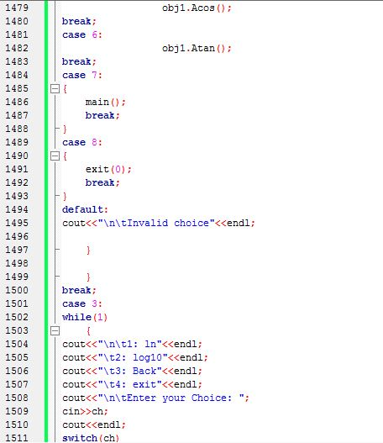
Continue…………………….

Slide 42
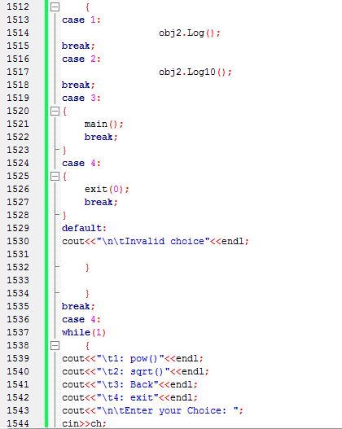
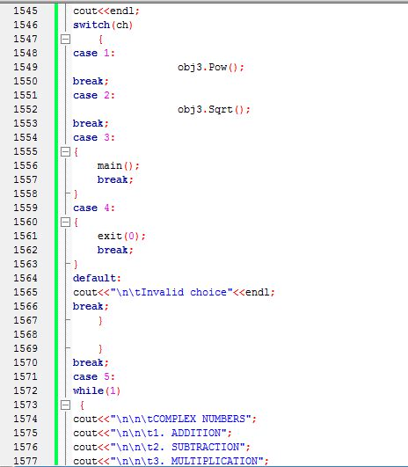
Continue…………………….

Slide 43
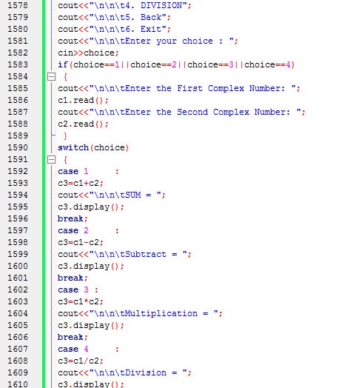
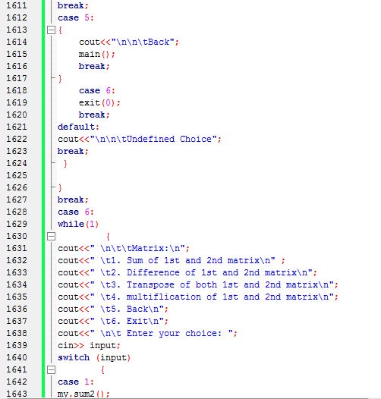
Continue…………………….

Slide 44
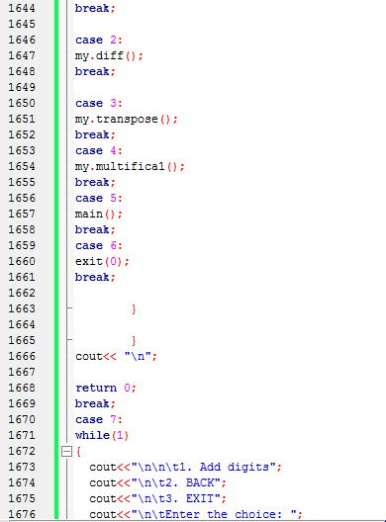

Continue…………………….

Slide 45


Continue…………………….

Slide 46


Continue…………………….

Slide 47


Continue…………………….

Slide 48


Continue…………………….

Slide 49


Continue…………………….

Slide 50


Continue…………………….

Slide 51


sample input and output screenshot:

Slide 52


Continue……..

Slide 53


Continue……..

Slide 54


Continue……..

Slide 55


Continue……..

Slide 56


Continue……..

Slide 57


Continue……..

Slide 58


Continue……..

Slide 59


Continue……..

Slide 60


Continue……..

Slide 61


Continue……..

Slide 62


Continue……..

Slide 63


Continue……..

Slide 64


Continue……..

Slide 65


Continue……..

Slide 66


Continue……..

Slide 67


Continue……..

Slide 68


Continue……..

Slide 69


Continue……..

Slide 70


Continue……..

Slide 71


Continue……..

Slide 72


Continue……..

Slide 73


Continue……..

Slide 74


Continue……..

Slide 75


Continue……..

Slide 76


Continue……..

Slide 77


Continue……..

Slide 78


Continue……..

Slide 79


Continue……..

Slide 80


Continue…………………..

Slide 81


Continue……..

Slide 82


Continue……..

Slide 83


Continue……..

Slide 84


Continue………

Slide 85


Continue……..

Slide 86


Continue……..

Slide 87


Continue…….

Slide 88


Continue…….

Slide 89


Continue……..

Slide 90


Continue……..

Slide 91


Continue……..

Slide 92


Continue……..

Slide 93


Continue……..

Slide 94


Continue……..

Slide 95


Continue……..

Slide 96


Continue……..

Slide 97
1.Remove all limitation in our project. 2.Extantion all functionarics activities. 3.Make porpect user useable calculator such as we use scientific calculator.
Future plan about our project:

Slide 98
1.OBJECT ORIENTED PROGRAMING IN C++ BOOK. 2.WWW.GOOGLE.COM. 3.SOME C++ AND PROJECT RELATED WEBSIDE. 4.ALSO SOME MAJOR instructions GIVEN BY OUR MONITOR.
Reference:

Slide 99
Overview total presentation:

Slide 100
Conclution:

Slide 101
THANK YOU ALL

